Slide 1
UnFlow
Unsupervised Learning of Optical Flow with a Bidirectional Census Loss
Image and Video Pattern Recognition Lab.
2018.02.09
김우진/2017321146

Slide 2
Contents
Why UnFlow
FlowNet
Limitation
UnsupFlownet
Author’s Contribution
UnFlow
Datasets & Results

Slide 3
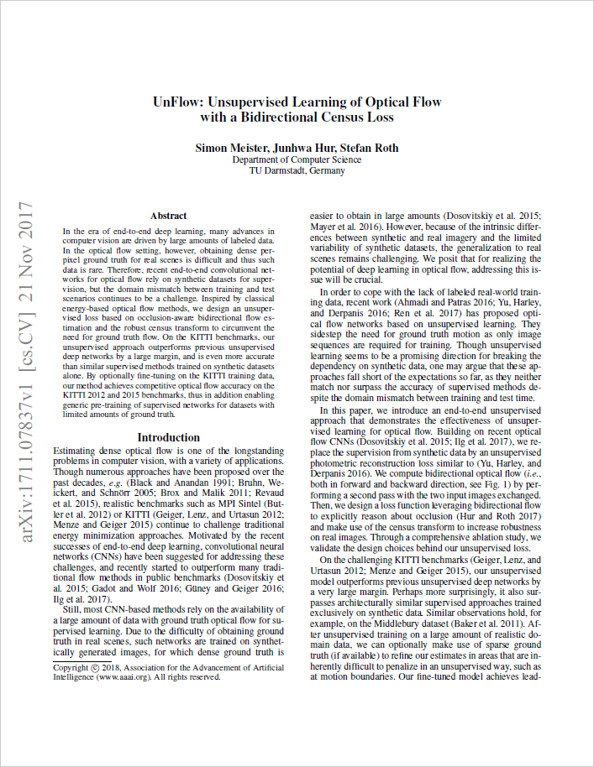
[UnFlow]
Unsupervised Loss
Predicts optical flow through unsupervised learning
Defining several Loss
Outperforms on KITTI & Middlebury(Higher accuracy)

Slide 4
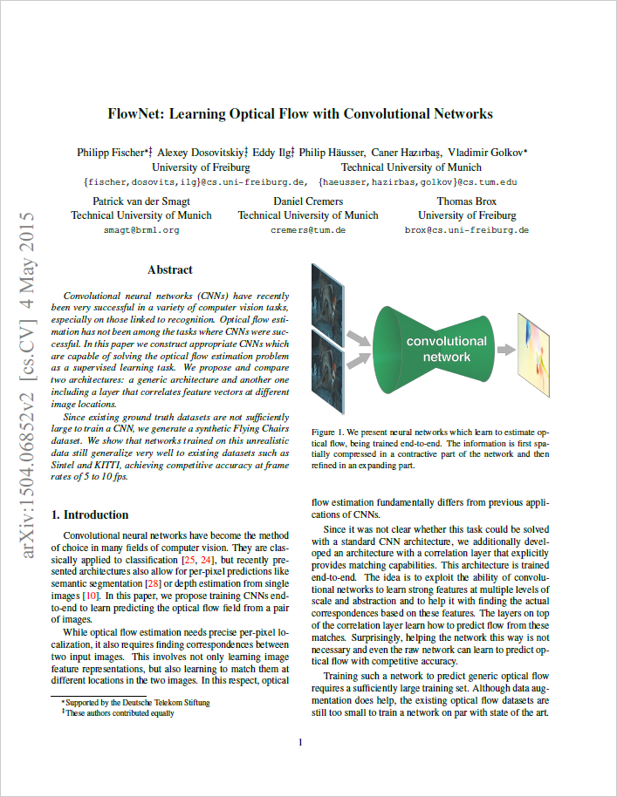
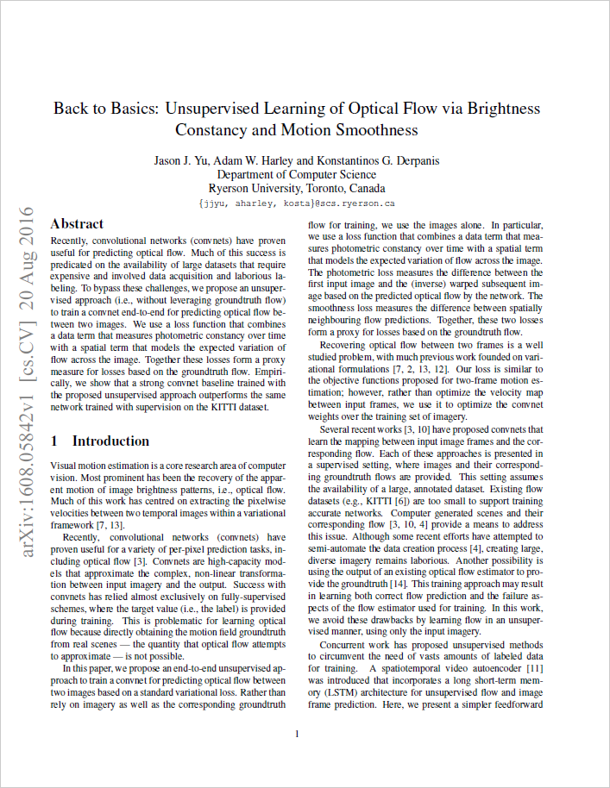
[UnFlow] FlowNet & UnsupFlownet

Slide 5
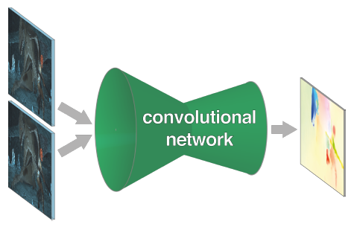
[FlowNet] Network
Encoder – Decoder 구조
Extracts a rich feature representation
Produces the high resolution flow

Slide 6
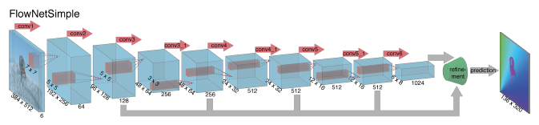
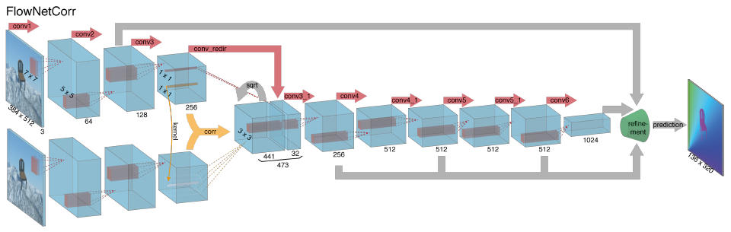
[FlowNet] Network
FlowNet Simple
FlowNet Correlation

Slide 7
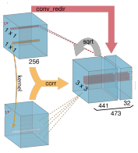
[FlowNetC] Correlation Layer
Encoder 구조
Correlation Layer
1x1
41x41
21x21
1x1
41x41
relative displacement !
large
small
large
-center-

Slide 8
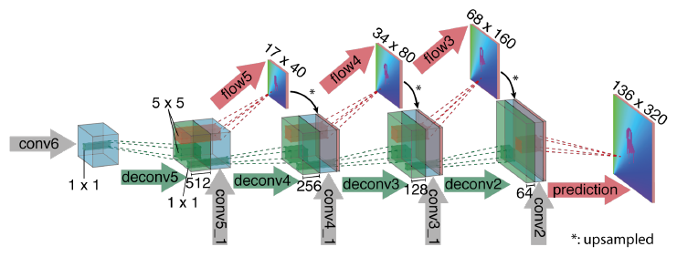
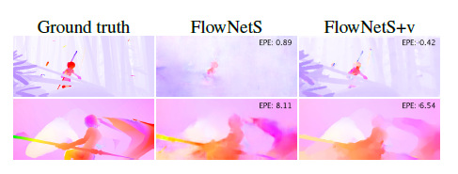
[FlowNet] Network
Decoder 구조
Variational refinement
: Bilinear up-sampling을 하지 않고 Boundary 와 Smoothness를 고려해서 Up-sampling 하겠다.
FlowNetS : Bilinear Upsampling
FlowNetS + v : Variational refinement
[2011 PAMI] Large displacement optical flow: descriptor matching in variational motion estimation

Slide 9
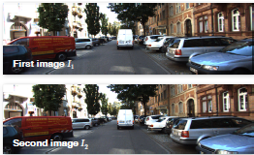
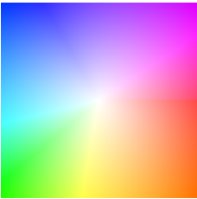
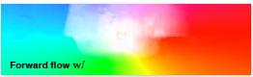
[FlowNet] Optical Flow Image
Frame 1
+
Frame 2
Optical Flow Image 는 한 픽셀당 방향(2개의 값)을 나타냄
이를 색으로 표현
Optical Flow

Slide 10
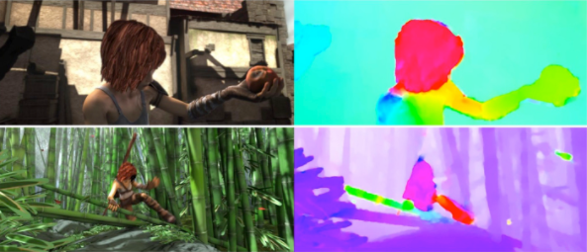
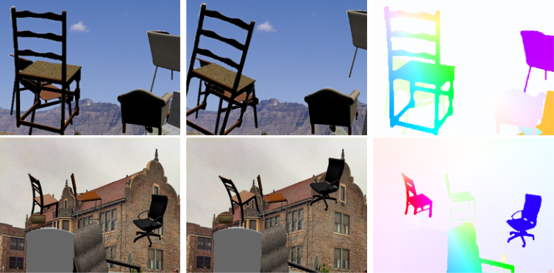
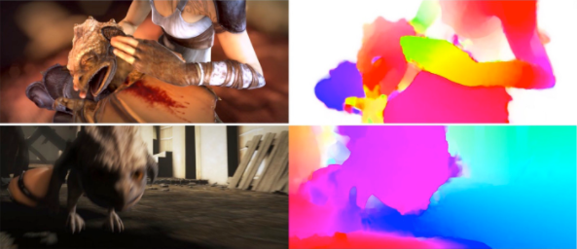
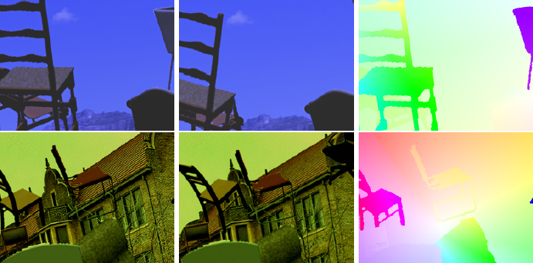
[FlowNet] Synthetic Data
Training Set
Test Set
Sintel
Flying Chairs
Large Displacement
Small Displacement

Slide 11
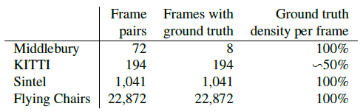
[FlowNet] Dataset
Optical Flow는 정확한 pixel localization이 필수
(Accuracy of the pixel displacement)
정확한 Optical Flow의 예측은 많은 양의 Training data 필요
( ex. Flying Chairs, Sintel)
FlowNet은 좋은 GT가 있으면 학습이 잘 될 것이라고 생각함.
(Supervised Learning의 단점, Unflow 는 이를 보기 좋게 극복함)

Slide 12
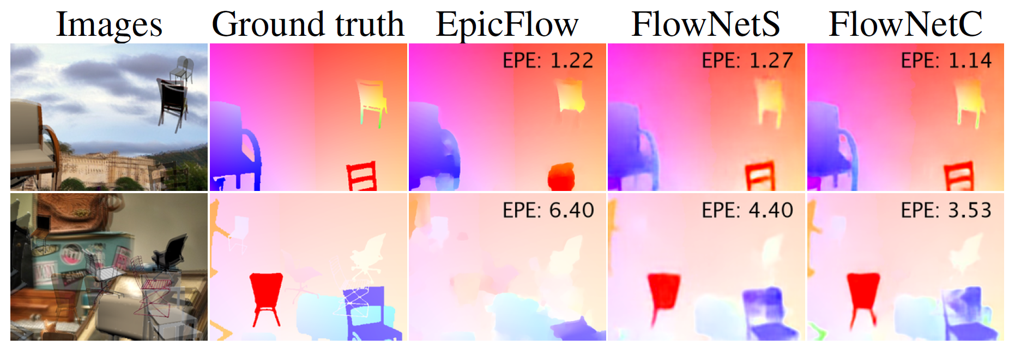
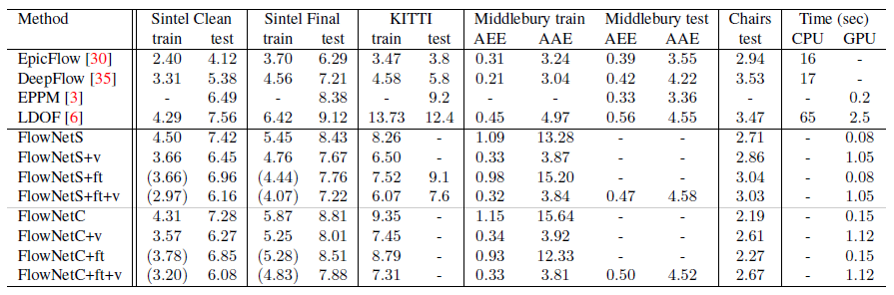
[FlowNet] Limitation
ft : fine-tuned network
v : variational refinement(bilinear 가 아닌 잘 Up-sampling 한 거)

Slide 13
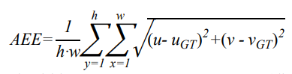
[FlowNet] Limitation
Average Endpoint Error (EPE)
Optical image는 한 픽셀 값에서
두개의 값
(방향 벡터)를 갖는다.
h,w : image height and width
u,v : vector component of the calculated optical flow
u_GT,v_GT : Ground truth of optical flow

Slide 14
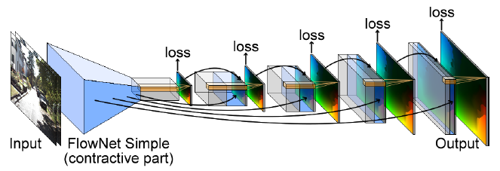
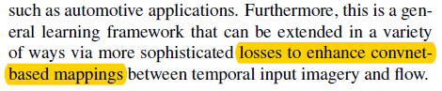
[UnsupFlownet] Network
Stack losses in between
- Loss uses photometric and smoothness in the intermediate flow
- Weighted sum of the losses.
[2011 PAMI] Back to Basics: Unsupervised Learning of Optical Flow via Brightness Constancy and Motion Smoothness

Slide 15
[UnFlow] Contribution
Unsupervised Loss
Occlusion-aware loss based on bidirectional optical flow estimation
Train FlowNetC with our comprehensive unsupervised loss
Iterative refinement by stacking multiple FlowNet networks

Slide 16
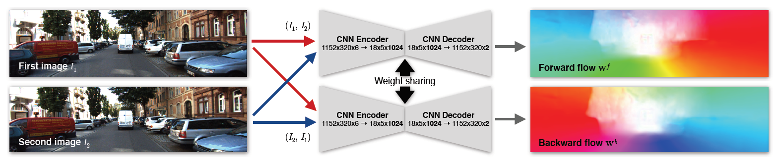
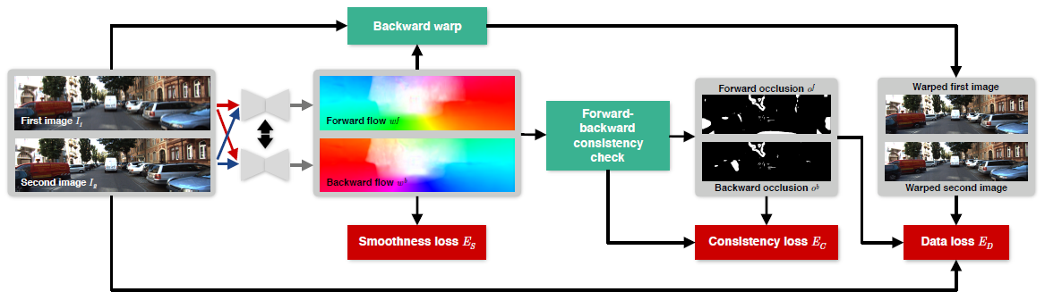
[UnFlow] Network
Bidirectional Flow
Schematic of unsupervised loss

Slide 17
[UnFlow] Occlusion-aware based Bidirectional Flow
Bidirectional Flow
- Forward-backward consistency
- Penalize their difference
- Mask the differences in the data loss

Slide 18
[UnFlow] Occlusion-aware based Bidirectional Flow
Schematic of unsupervised loss
Minimization of losses
- Smoothness loss : the difference between spatially neighboring flow predictions
Consistency loss : loss sum of forward-backward
Data loss : photometric differences of the warped images

Slide 19
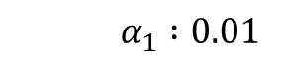
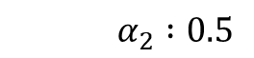
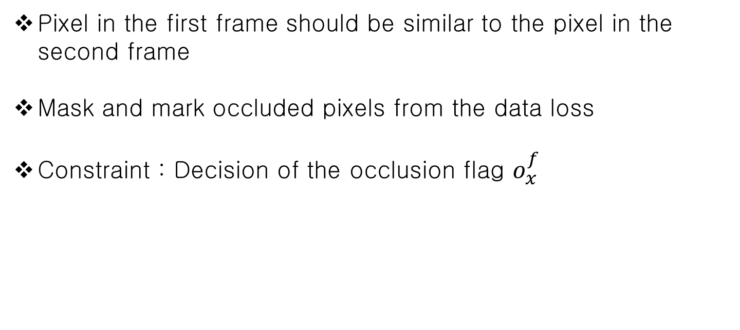
[UnFlow] Unsupervised Loss
Pixel in the first frame should be similar to the pixel in the second frame
Mask and mark occluded pixels from the data loss
Constraint : Decision of the occlusion flag $o_{x}^{f}$
${|w^{f}\left(x\right)+w^{b}(x+w^{f}(x))|}^{2}$ < $α_{1}({\left|w^{f}\left(x\right)\right|}^{2}+{|w^{b}(x+w^{f}\left(x\right))|}^{2}$+ $α_{2}$
$$α_{1} :0.01$$
$$α_{2} :0.5$$

Slide 20
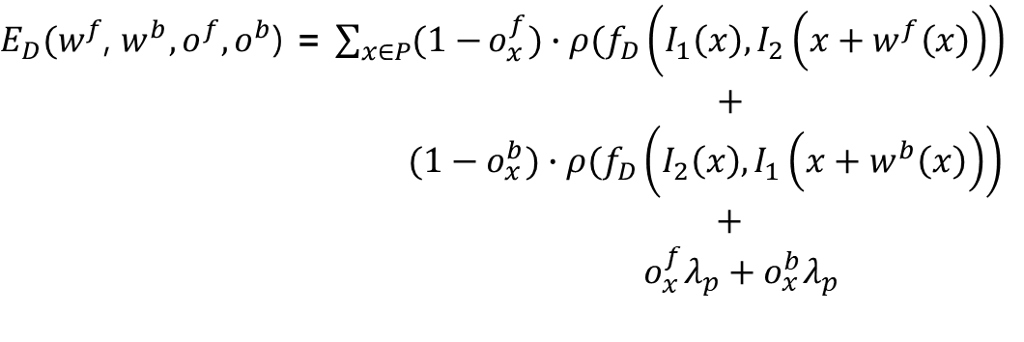
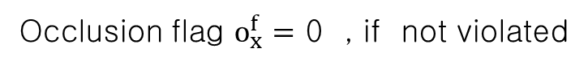
[UnFlow] Unsupervised Loss
Occlusion-aware data loss :
Occlusion flag $o_{x}^{f}=1$ , if constraint is violated
Occlusion flag $o_{x}^{f}=$ 0 , if not violated
$E_{D}(w^{f}$, $w^{b},o^{f},o^{b}$) = $\sum_{x∈P}{(1−}o_{x}^{f})∙ρ(f_{D}\left(I_{1}\left(x\right),I_{2}\left(x+w^{f}\left(x\right)\right)\right)$
$+$
$(1−o_{x}^{b})∙ρ(f_{D}\left(I_{2}\left(x\right),I_{1}\left(x+w^{b}\left(x\right)\right)\right)$
$+$
$o_{x}^{f}λ_{p}+o_{x}^{b}λ_{p}$
$$ρ\left(x\right)={{(x}^{2}+ε^{2})}^{2} : Charbonnier penalty function$$
$$λ_{p} :Constant penalty for occluded pixels$$
$$f_{D}\left(I_{1}\left(x\right),I_{2}\left(x^{′}\right)\right) :Photometric difference between corresponding pixel x$$

Slide 21
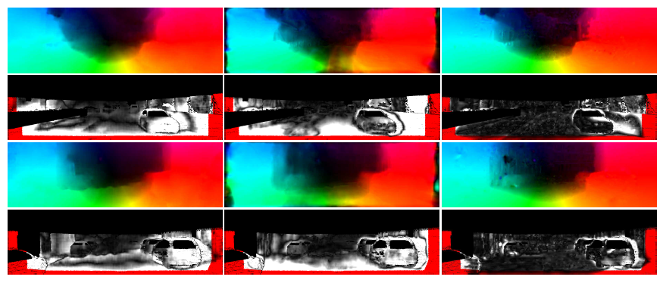
[UnFlow] Results
Visual comparison on KITTI 2012
FlowNetS
UnsupFlownet
UnFlow-CSS

Slide 22
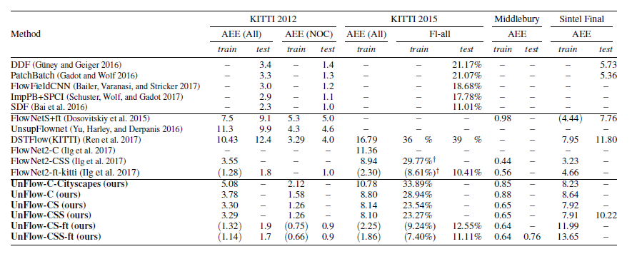
[UnFlow] Results
Accuracy comparison on KITTI, Middlebury and Sintel

Slide 23
Thank You

